Slide 1

Lesson 1.2 : Building Blocks
Microsoft Philanthropies TEALS Program
Introduction to Computer Science

Slide 2
After this lesson you should be able to:
Define and identify "blocks," "scripts," "sprites," and "the stage" in SNAP
Write simple SNAP programs
Describe what simple SNAP programs do without executing the code

Slide 3
Today’s Plan
Do Now
Lab
Debrief

Slide 4


Do Now 1.2
Using the internet, define the following terms:
Tracing through code
Debugging
Notes:
https://tealsk12.gitbook.io/intro-cs/unit_1/lesson_12#instructors-notes
Do Now Debrief:
Tell the story of Admiral Grace Hopper who originated the term "Debugging"
Review the basics of SNAP from the previous lesson
Ensure that students can:
Define "block" and "script"
Describe how to build a script (snapping blocks together)
Explain how scripts are executed (one block at a time in order)
Introduce the concept of block categories
Ask students to consider why categories are helpful as opposed to having a simple list of blocks

Slide 5
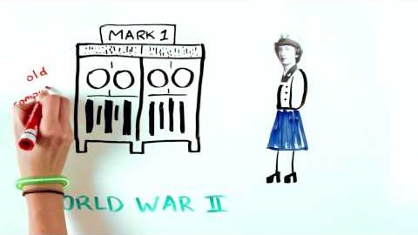
Who is Grace Hopper?
Notes:
Do Now Debrief:
Tell the story of Admiral Grace Hopper who originated the term “Debugging”
You could also use this Who is Grace Hopper? Video: https://youtu.be/Fg82iV-L8ZY
Review the basics of Snap! from the previous lesson
Ensure that students can:
Define block and script.
Describe how to build a script (snapping blocks together).
Explain how scripts are executed (one block at a time in order).
Introduce the concept of block categories.
Ask students to consider why categories are helpful as opposed to having a simple list of blocks.

Slide 6

Lab 1.2 – Snap! Scavenger Hunt
Explore the functionality of some common blocks
Practicing navigating though the blocks in SNAP
Build a SNAP program
Notes:
https://tealsk12.gitbook.io/intro-cs/unit_1/lesson_12#instructors-notes
Individually or in heterogeneous pairs as described in previous lessons, have students work through the "SNAP Scavenger Hunt" activity
Students should turn in answers to all questions and SNAP programs for the final problems
Consider gamifying the worksheet or debrief as an online poll and/or quiz

Slide 7

Debrief
Notes:
Go through each question or prompt in parts 1 and 2 and ask students to share their answer
Cold calling alternative: Write each student’s name on an index card and shuffle the cards. Next, ask a few “review” questions to set the stage that ask for application (or creativity, or evaluation) and have no single “right answer.” Give students 30 to 60 seconds to formulate an answer. You can have them talk in pairs or groups for a few minutes as well if you prefer. It’s only after students have been thinking that you take the top card to see who answers. Sometimes you can say something like, “If you don’t know, make something up like you would on a mid-term, and then we’ll all help you develop better answers.” The student takes their best shot, knowing that others will help if necessary. At that point you have lots of options: You can ask a follow-up to the same student, pick another card and have somebody else answer the follow-up, or simply have students volunteer to expand on the first answer.
Point out the color coding for each category
Emphasize important details in some of the blocks listed in part 2, such as:
the block will leave the bubble on the stage until something else is thought
the and blocks require explicit x- and y-coordinates
Solicit a few student responses for each category in part 2.2 before commenting yourself
Try to guide the students to discuss with each other and settle on a description for each category with minimal instructor intervention
Discuss one or two student solutions to each of the SNAP programming problems
Either solicit volunteers or use cold call alternative
Point out differences between student solutions and call attention to the fact that there is more than one way to solve a problem

Slide 8

Exit Ticket
In your notebook, describe two categories of blocks.

